Slide 1

Bharat Herald: Data-Driven Roadmap for Survival in the Digital Era
An Analytical Study (2019–2024) by Sai Abhilash on Print Decline, Digital Readiness, and Strategic Transformation

Slide 2
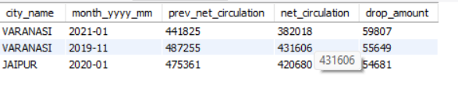
1-Top 3 Months of Sharpest Circulation Decline (2019–2024)
Report showing the top 3 months (2019–2024) where any city recorded the sharpest month-over-month decline in net circulation.
📝 Results
Varanasi recorded the highest month-over-month circulation drop in Jan 2021 (↓ 59,807 copies).
The second sharpest decline was also in Varanasi (Nov 2019) with a drop of 55,649 copies.
Jaipur showed the third largest decline in Jan 2020, with a drop of 54,681 copies.
📌 These represent the top 3 sharpest declines in monthly circulation across cities during 2019–2024.

Slide 3
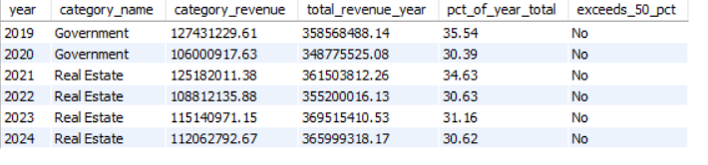
2-Which ad categories contributed more than 50% of the total yearly ad revenue?
Yearly Ad Categories Exceeding 50% of Total Revenue Contribution
Result Summary:
From 2019 to 2024, no ad category contributed more than 50% of the yearly total ad revenue
The highest contribution observed was in 2019 (Government, 35.54%).
In other years, the top category contributions ranged between 30% and 35%, which is well below the 50% threshold.
👉 Therefore, no category qualifies under the business request criteria.

Slide 4
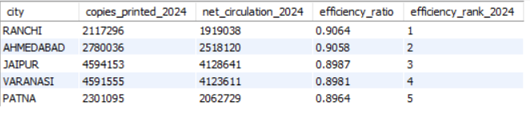
3-2024 Print Efficiency Leaderboard – Top 5 Cities
Ranking cities by print efficiency (net circulation ÷ copies printed) to highlight the most effective print performers of 2024.
Result Summary:
For 2024, the Top 5 most efficient print cities are:
Ranchi – Efficiency: 0.9064
Ahmedabad – Efficiency: 0.9058
Jaipur – Efficiency: 0.8987
Varanasi – Efficiency: 0.8981
Patna – Efficiency: 0.8964
📌 Key Insight: Ranchi leads the leaderboard with the highest print efficiency (90.64%), closely followed by Ahmedabad (90.58%).

Slide 5
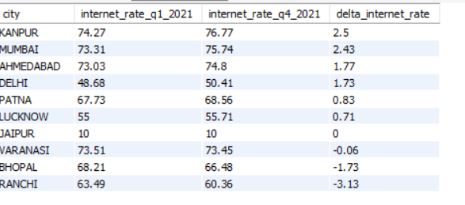
4 - Internet Readiness Growth by City – 2021
Change in internet penetration from Q1 to Q4 of 2021
RESULTS SUMMARY
Kanpur led internet readiness growth in 2021 (+2.5), outpacing all other cities.
Mumbai and Ahmedabad showed strong gains, reflecting rising digital adoption.
Delhi, Patna, and Lucknow grew steadily but at a slower pace.
Jaipur showed no growth, signaling market stagnation.
Ranchi and Bhopal declined, highlighting regional digital challenges.

Slide 6
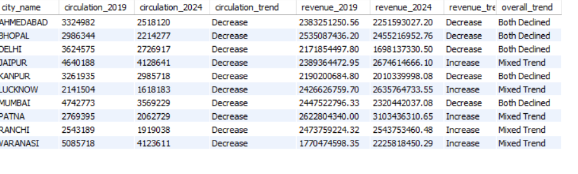
5 - Cities with Consistent Multi-Year Decline (2019–2024)
Identifying cities where both net circulation and ad revenue strictly decreased year-over-year
Ahmedabad, Bhopal, Delhi, Kanpur, and Mumbai show consistent multi-year decline in both circulation and revenue (2019–2024).
Other cities (Jaipur, Lucknow, Patna, Ranchi, Varanasi) faced circulation decline but sustained/increased revenues, indicating mixed resilience.

Slide 7
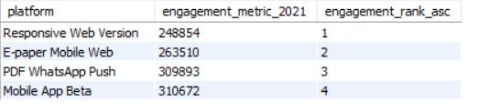
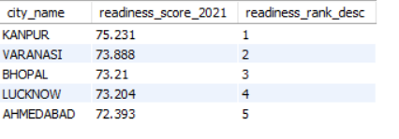
6-Digital Readiness–Engagement Mismatch 2021: Kanpur as the Outlier
Despite leading in digital readiness, Kanpur ranked among the bottom 3 in pilot engagement metrics.
Observation:
Kanpur has the highest readiness score (75.23, Rank #1).
Engagement ranking is based on platform metrics, where the bottom 3 are:
PDF WhatsApp Push (Rank 3)
Mobile App Beta (Rank 4)
E-paper Mobile Web (Rank 2) → depending on cut-off definition.
Since Kanpur is #1 in readiness, but engagement falls into the lower-ranked pilot platforms, it qualifies as the outlier.

